Slide 1

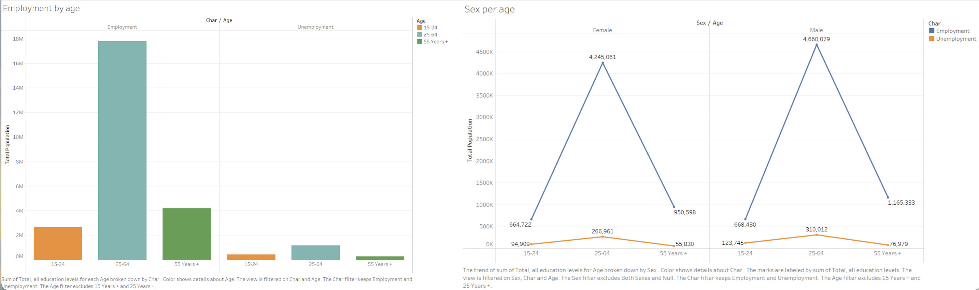
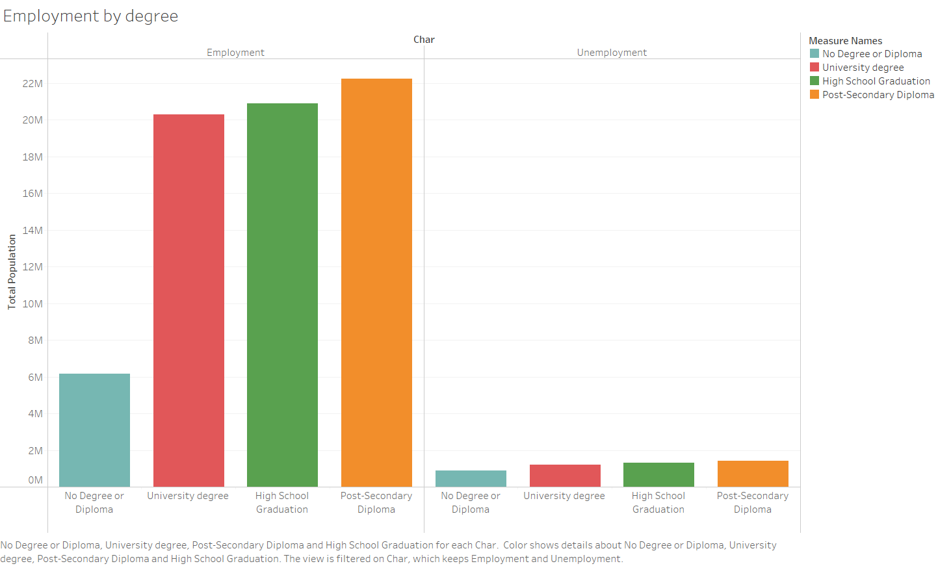
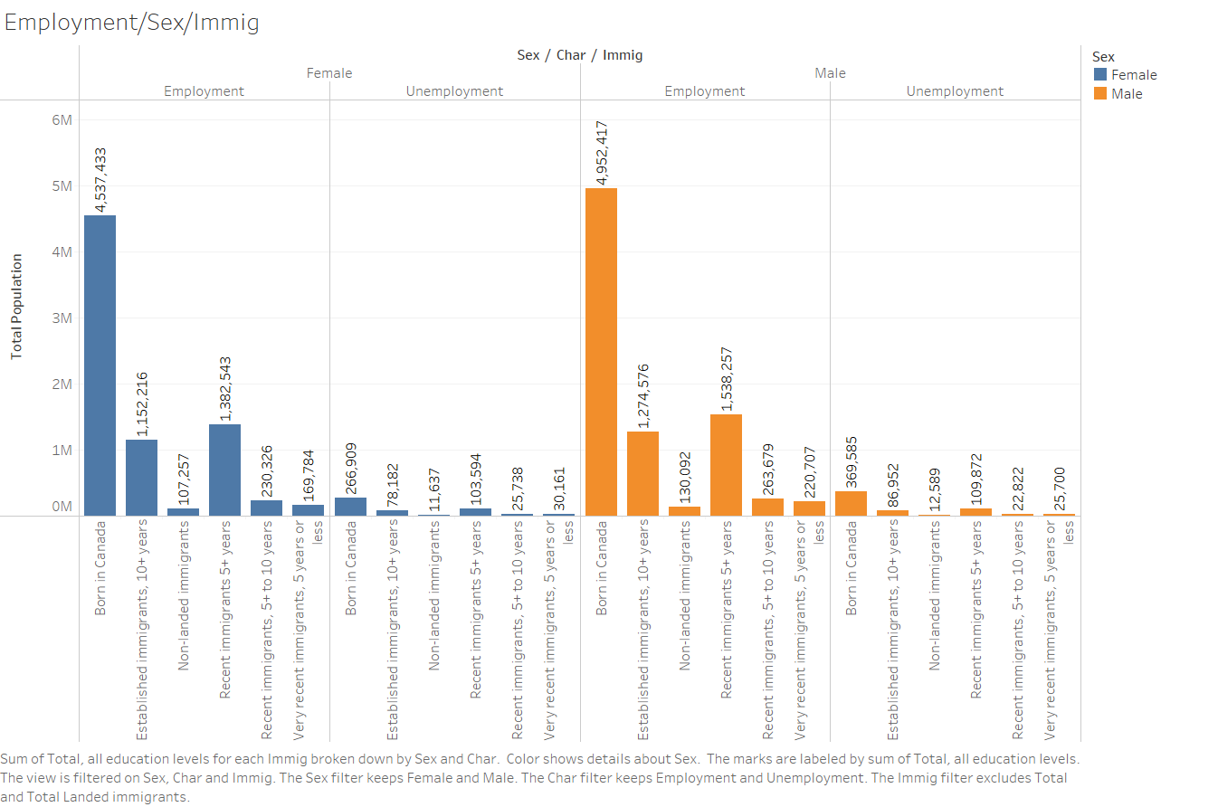
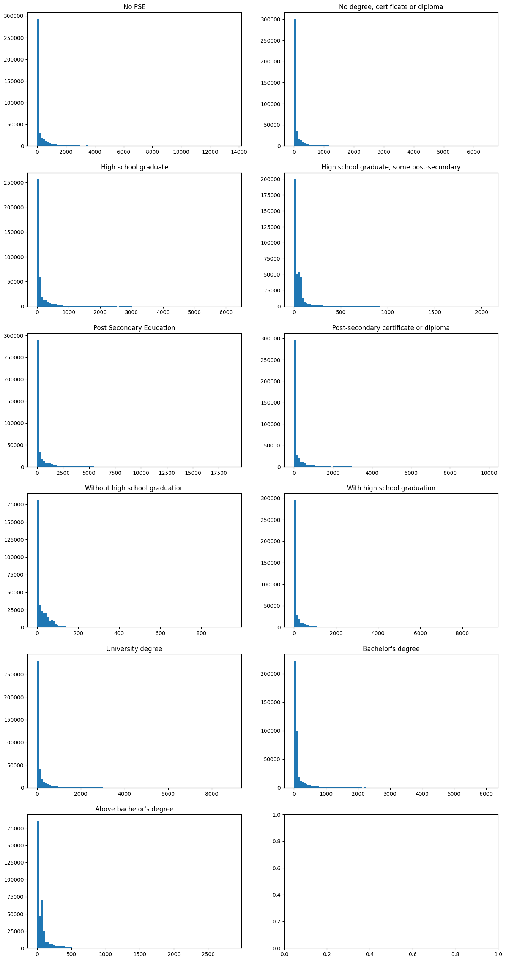
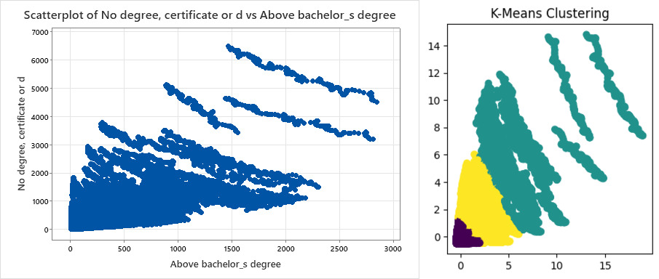
EMPLOYMENT PATTERNS IN CANADA: A DEMOGRAPHIC OVERVIEW Prepared by Harsh Vyas, Satish Singamaneni, Daksh Patel, Ajay Navadiya
INTRODOUCTION
Welcome to 'Employment Patterns in Canada: A Demographic Overview.' This poster delves into the intricate tapestry of Canada's labor force, unraveling key insights on employment and unemployment. Through a nuanced exploration of demographics such as sex, immigration status, and education, we navigate the dynamic landscape of the Canadian job market. This comprehensive analysis of labor force estimates by immigration provides a lens into the multifaceted factors shaping employment trends, offering valuable perspectives for understanding the diverse workforce contributing to Canada's economic fabric.
ANALYSIS
The histogram illustrates the frequency distribution of numeric columns within the Labor Force estimates by immigration in Canada dataset. This dataset encompasses population data categorized by educational levels, alongside additional parameters like sex, age, and immigration status. Notably, a substantial concentration of values was observed in the bin proximate to zero, with the median aligning with the first bin. Utilizing 100 bins, we employed this distribution to impute all continuous columns (excluding TOTAL) using the median, subsequently predicting the TOTAL column through a machine learning model. The Random Forest Regressor achieved an impressive accuracy of 99.99%.
INSIGHTS
INSIGHTS
The bar chart provides a comparison of employment across different age groups (15-24, 25-64, and 55+), while the line graph illustrates the distribution of employment status (Employed and Unemployed) concerning age and gender.
Key insights derived from both the line chart and the bar chart are as follows:
Among employed individuals, the age group 25-64 exhibits the highest population compared to other age groups, with the 15-24 age group having the lowest employment rate. Within the 25-64 age group, where the majority of the employed population lies, the male population surpasses the female population by 415,018.
For those unemployed, the age group 25-64 again has the highest population, while the 55+ age group has the lowest. In the 25-64 age group, which accounts for the majority of the unemployed population, the male population exceeds the female population by 43,051.
Combining the above two observations, it can be concluded that the highest number of population falls within the 25-64 age group.
The bar chart illustrates the correlation between educational levels and employment and unemployment.
The key observations are as follows:
The highest employment rate is observed among Post-secondary certificate and Diploma holders, while simultaneously, this category exhibits the highest unemployment numbers. This suggests that individuals with education constitute the largest population in Canada.
Post-secondary Individuals with no degree or diploma have the lowest employment numbers, and those with a degree and diploma have the lowest unemployment numbers. This indicates that the population of individuals without a degree or diploma is the smallest.
The provided bar graph illustrates the employment status (Employed or Unemployed) differentiation between males and females across various immigration statuses, including ['Total', 'Total Landed immigrants', 'Very recent immigrants, 5 years or less', 'Recent immigrants 5+ years', 'Recent immigrants, 5+ to 10 years', 'Established immigrants, 10+ years', 'Non-landed immigrants', 'Born in Canada’].
Key insights derived from the graph are as follows:
Born-in-Canada immigrants exhibit the highest employment rate. The employed population among female-born-in-Canada immigrants is nearly 1.5 times, and among male-born-in-Canada immigrants, it is approximately 1.4 times greater than the combined employed population of all other immigration statuses.
Born-in-Canada immigrants also display the highest unemployment rate. The unemployed population among female-born-in-Canada immigrants is nearly the same, and among male-born-in-Canada immigrants, it is roughly two times greater than the combined unemployed population of all other immigration statuses.
Combining the findings from the above two conclusions, it can be deduced that immigrants born in Canada constitute a significantly larger population compared to all other types of immigrants in Canada . When compared with other immigrant groups, with 103,594 females and 139,527 males employed, and 20,207 females and 57,000 males unemployed.
The presented scatter plot compares individuals with a bachelor's degree to those without any degree under specific conditions.
The key observations are as follows:
The data underwent analysis using the K-means clustering algorithm. The observations revealed a substantial cluster near 0, suggesting a significant presence of both employed and unemployed individuals. In contrast, the other two clusters exhibited higher standard deviation and bias.
CONCLUSIONS
Based on the analysis of seven graphs, it is evident that males in the age range of 25 to 64, born in Canada, and possessing a postsecondary degree or diploma exhibited the highest employment rate. Conversely, males within the same age range and born in Canada but lacking a degree demonstrated the highest unemployment rate.

